Slide 1
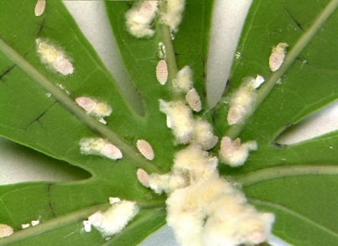
Invasive Species Compendium Instruction Manual
A self-teaching and reference tool 2. Advanced searching, creating lists and the bibliographic database
Created in support of Invasive Species Compendium outreach activities supported by European Commission Directorate-General for Environment; Thematic Programme for Environment and sustainable management of Natural Resources including Energy

Slide 2

This manual was produced as part of EUROPEAN COMMISSION DIRECTORATE-GENERAL ENVIRONMENT Contribution Agreement N° 21.0401/2011/609860/SUB/B2: "Updating, maintaining and enhancing the Invasive Species Compendium"
Cover Picture: Adults of Phenacoccus manihoti (cassava mealybug) . Copyright: Georg Goergen/IITA Insect Museum, Cotonou, Benin

Slide 3
The aims of the second part of this training manual are to:
Take another look at datasheets as a source of useful lists
Introduce Advanced Searching for datasheets in the Compendium
Show how the Compendium Advanced Search can be used for creating useful species lists
Introduce the Compendium Expert Search function
Demonstrate the Compendium Bibliographic database with some useful search strings
Demonstrate some of the other resources available in the Compendium
Notes:
In this self-learning slide show manual there are notes relating to each slide.
It should be possible to follow this teaching tool without reading the notes.
However, the notes give a little more information regarding the activities illustrated in the slides and about the Compendium in general. They would also be useful to anyone using this slide series as a visual aid in demonstrating to others.

Slide 4
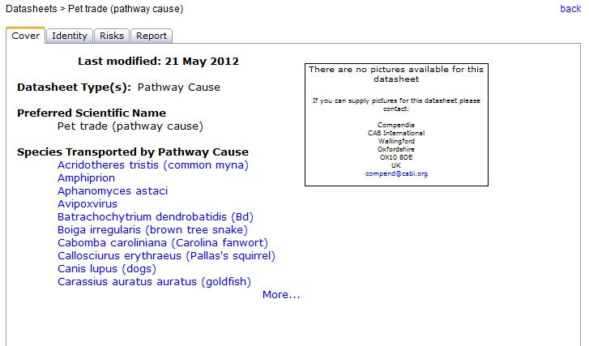
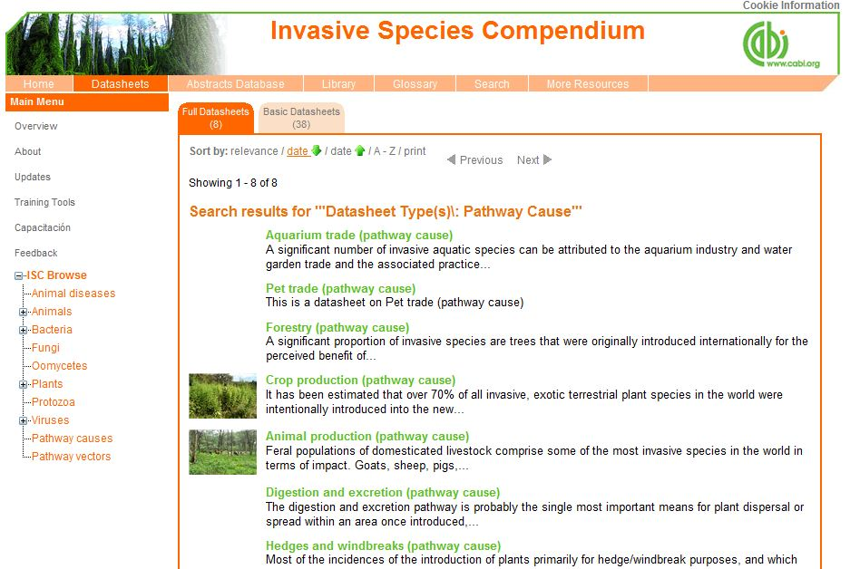
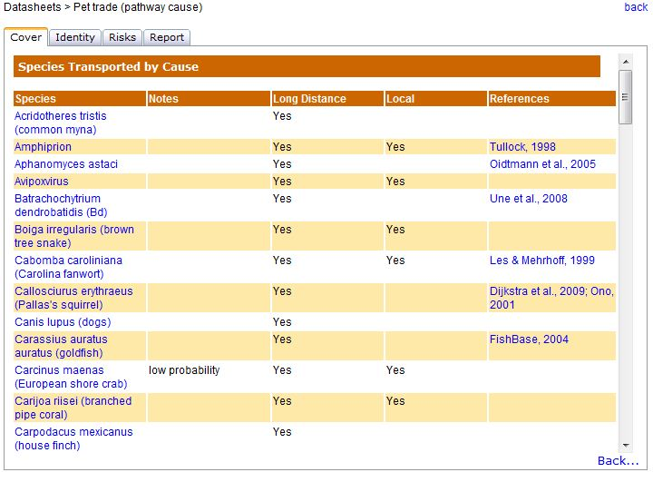
Datasheets and useful lists
Pathway Cause / Pathway Vector datasheets
Species Transported by Pathway
Notes:
One of the advantages of the relational nature of the database of datasheets in the ISC is the way in which it enables lists to be created of datasheets associated with other datasheets. For example, Pathway datasheets have lists of species introduced via the pathways that they represent, such as the list of species transported via the Pet Trade shown in this illustration. There follows some examples of other tables of useful lists that can be found on different types of datasheets – these examples are not exhaustive and there are further useful examples to be found in the Compendium.

Slide 5
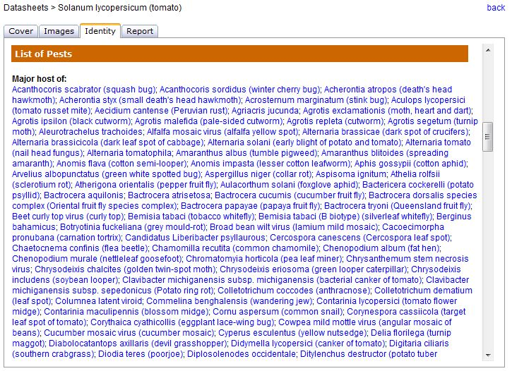
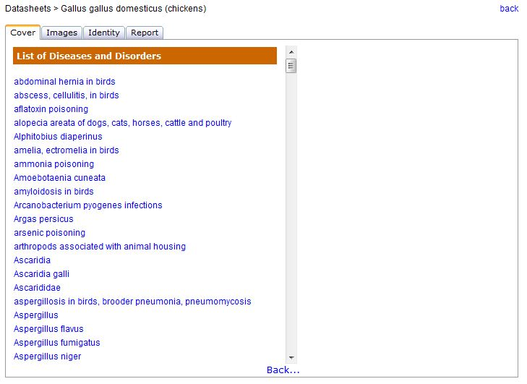
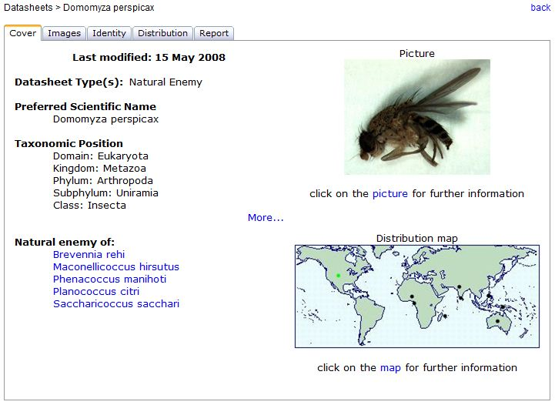
Datasheets and useful lists
Host Plant / Animal datasheets
List of pests and diseases
Natural Enemy datasheets
List of species for which it is a Natural enemy
Notes:
Host Plant and Host Animal datasheets have a list of pests and diseases that affect or infect them.
Datasheets of species classified as Natural Enemies have a lists of organisms with which the species is associated as a predator or pathogen ‘Natural enemy of’:.

Slide 6
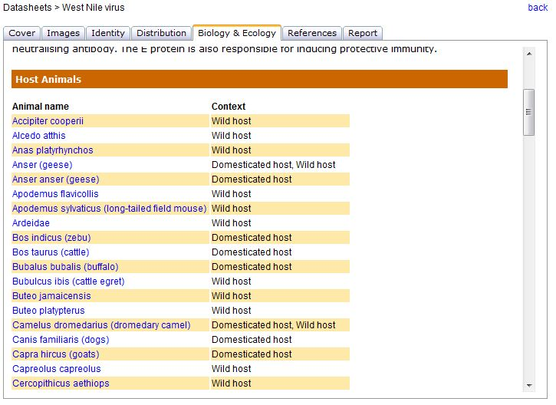
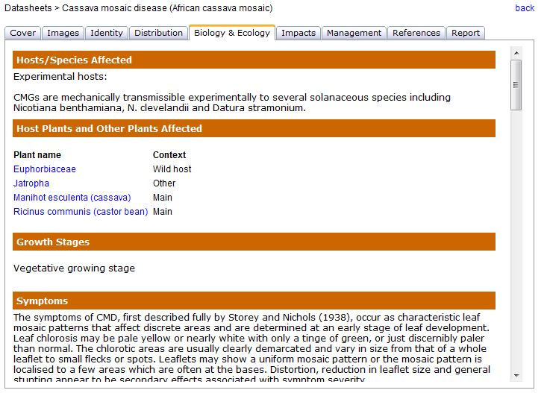
Datasheets and useful lists
Pest / Disease datasheets
Lists of Host plants/animals and plants/animals affected
Notes:
Datasheets for Pests and Diseases have lists hosts or animals/plants affected by them.

Slide 7
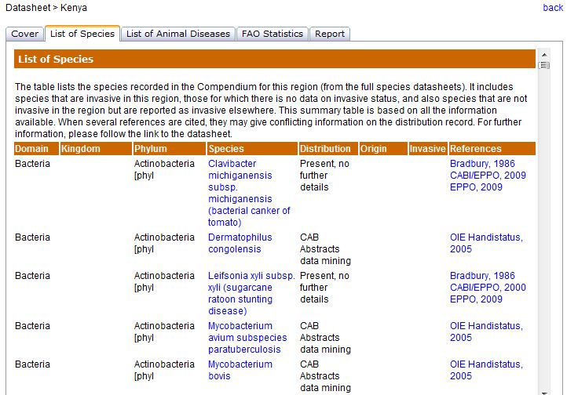
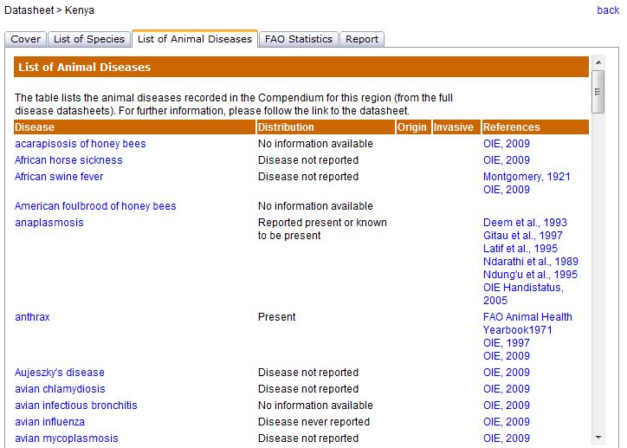
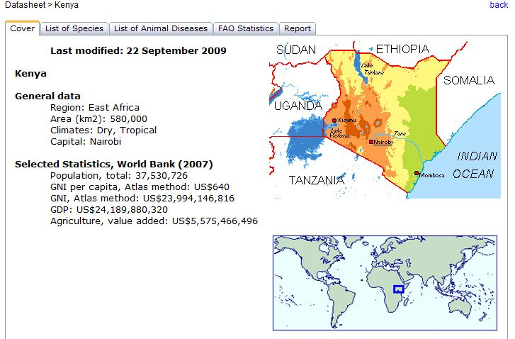
Datasheets and useful lists
Country datasheets
Distribution data
Notes:
Country datasheets have lists of linked distribution data for both species and diseases of animals. Note, however that these data include records of presence of invasive species, but also other geographical references such as ‘absence’ records, ‘last reported’ dates and references to native species. It is possible to copy and paste these tables into an Excel worksheet for further manipulation to assist in creating better representative national (or sub-national) lists of the types of occurrences desired by the user.

Slide 8
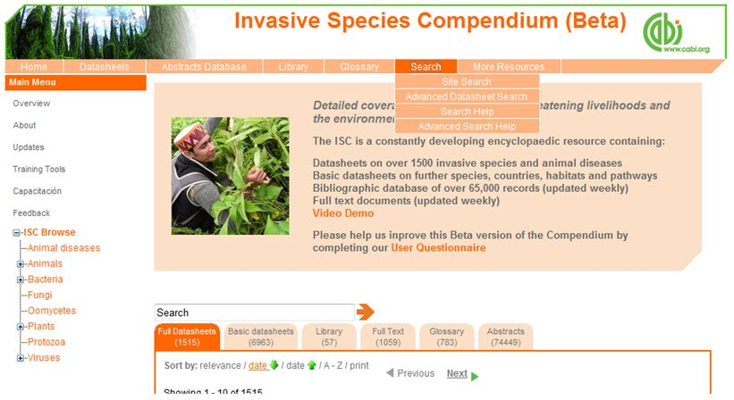
Advanced search options for searching datasheets
Advanced Datasheet Search and Search Help resources
Site search entry box
Notes:
In part 1 of this Invasive Species Compendium instruction manual, the user is introduced to the simple site search available from the Home Page.
Further search options are available from the orange, horizontal top menu bar. The ‘Search’ drop down menu provides further options for interrogating the datasheets.
Advanced searches are not only useful for finding datasheets, but are also useful for creating lists of species.
Click on the Advanced Datasheet Search option…

Slide 9
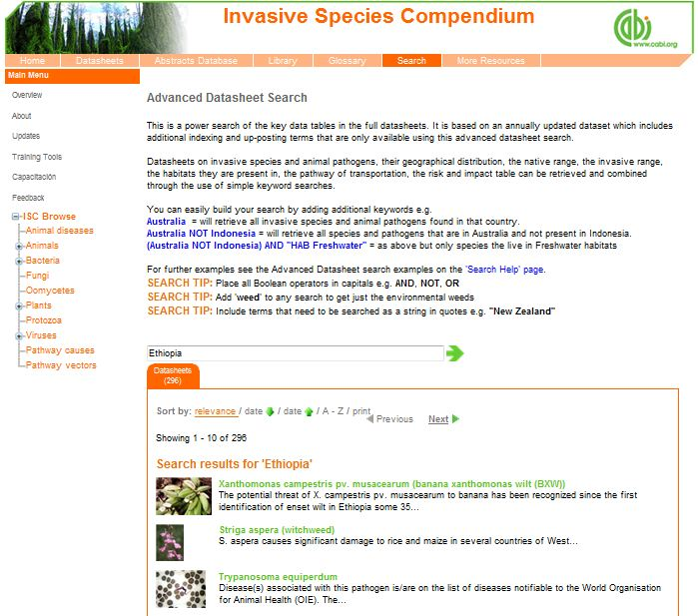
A simple, Advanced Search… ‘Ethiopia’
Sort the Advanced Search results by using the options here, and then create a list of species by mouse clicking on ‘print’
Notes:
The Advanced and Expert Search functionalities in the Compendium are best used when a list of species is required.
For example, type ‘Ethiopia’ into the Advanced Search box and then click the green arrow to the right.
This searches all the Full Datasheets to build a list of all species that are found in Ethiopia.

Slide 10
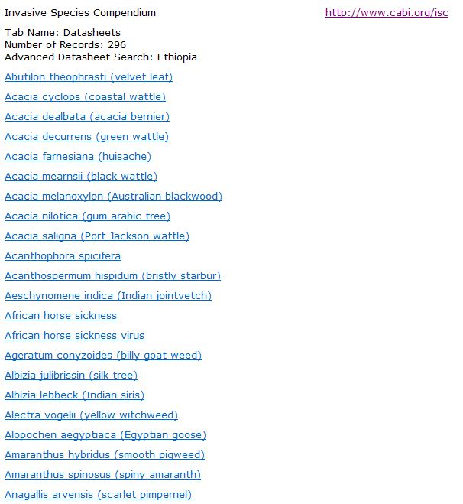
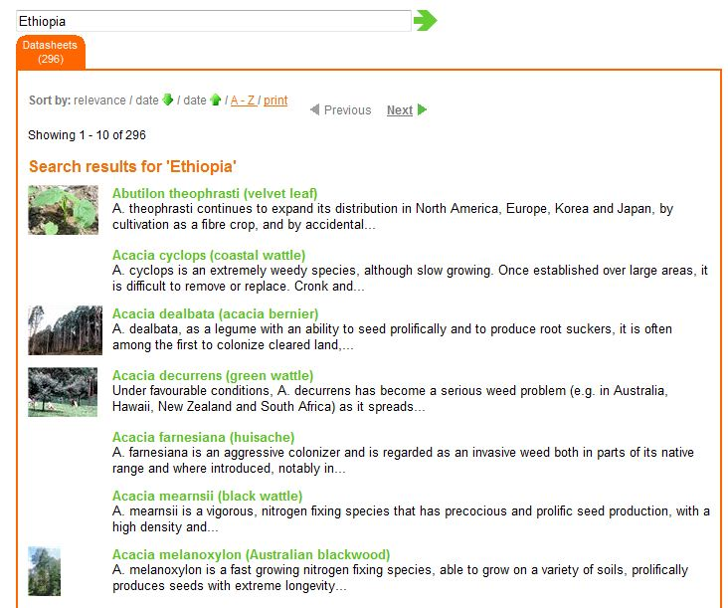
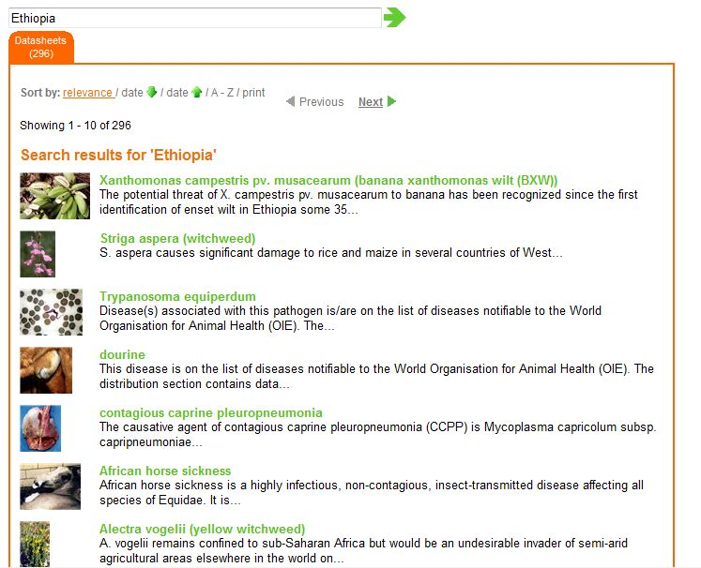
Species in the Compendium listed as present in Ethiopia
3. ‘Print’ – species list
2. Sorted A-Z
1. Default
Notes:
To create a list of species identified by the Advanced Search using ‘Ethiopia’; click ‘A-Z’ to organize the search results alphabetically, then click ‘print’ to create a printable list of species. This list is not only printable but is in a useful format to be copied and pasted into another document format; word processor or spread sheet.

Slide 11
Limitations of species lists generated using the Advanced Search
Species lists created using a country name in the Advanced Search box relate to species that are listed as present in that country. They may be:
Native to that country, but invasive elsewhere
Non-native and present in that country, but not invasive, invasive elsewhere
Non-native, present and invasive in that country
To refine you search take a look at ‘Expert Searching’ later in this document.
Notes:
Species lists of this kind, generated using the Advanced Search function are useful, but have their limitations. Further investigation of the species listed is needed if a list is required of, for example, species that are non-native and are invasive in a particular country.
However, using ‘Expert Search’ techniques as described later in this manual, it is possible to differentiate these search results into better-defined categories.

Slide 12
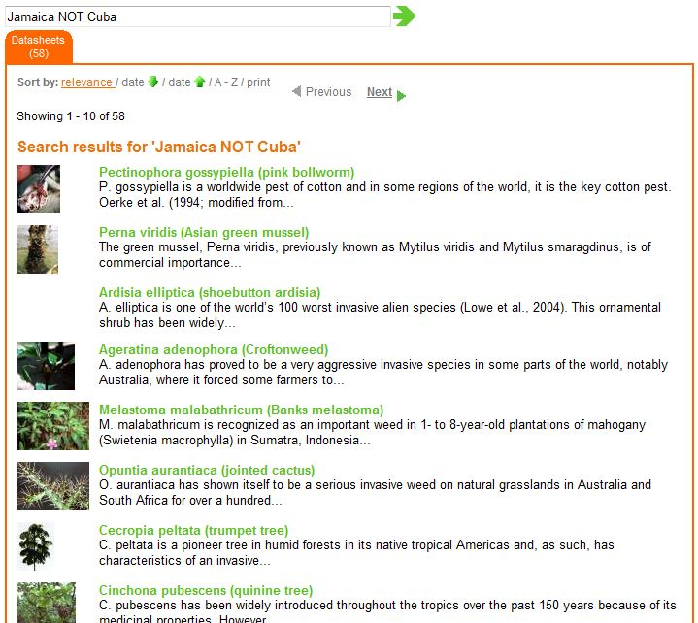
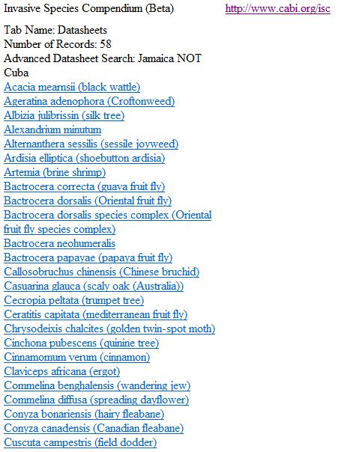
Using Boolean operators with Advanced Searches
Notes:
It is possible to create lists of species from the database of Full Datasheets using Boolean operators.
For example, the above search ‘Jamaica NOT Cuba’ can be used to find species listed in the Compendium as present in Jamaica but not present in Cuba.
Lists like this generated from the Advanced Search should be used with caution and should not be used as authoritative without further investigation of the species concerned.

Slide 13
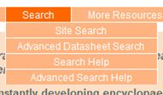
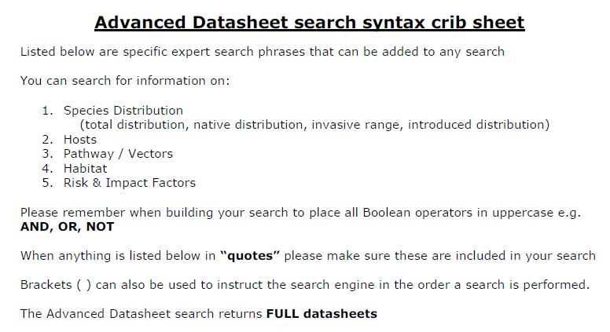
The Advanced Datasheet Search and Expert Searches… becoming a search expert…
Notes:
Again, using the Advanced Datasheet Search input box, but, by using controlled vocabulary and certain prefixes before search terms in building search strings, it is possible to build more refined and accurate searches.
This vocabulary and additional coding is available in the document retrieved by clicking ’Advanced Search Help’ in the ‘Search’ drop-down menu.

Slide 14
Useful prefixes to searches… Species Distribution
It is important to remember that these prefixes and the country name MUST be placed within quotation marks (“”) in the search box.
Geographical Distribution = “GEO country” – lists species listed as present in a country or not
Native distribution = “NAT country” – species listed as native in a particular country
Introduced distribution = “INT country” – lists species reported as being introduced into the country in the search term
Invasive range = “INV country” – lists species reported as being introduced into the country in the search term

Slide 15




Examples using Australia
Notes:
Results for Australia:
573 species covered by full datasheets listed as present in Australia
81 species covered by full datasheets listed as present and native to Australia
261 species covered by full datasheets listed as present and introduced to Australia
173 species covered by full datasheets listed as present and invasive in Australia
Remember that in interpreting the results there are many factors to consider; the search only involves Full datasheets, there may be some records of presence where no further information is given, e.g., evidence of invasiveness of a species is unknown or not reported, or it is not mentioned whether the species is native or introduced to a country.

Slide 16


Other useful prefixes for expert searches…
It is important to remember that these prefixes and the search term MUST be placed within quotation marks (“”) in the search box.
“HOS preferred name” To search for the invasive species and animal diseases that are associated with a named host
“HAB habitat name” To search for species associated with a particular habitat. Habitat names are listed as controlled vocabulary in the Advanced Help sheet.
Notes:
The searches demonstrated above list:
Species or diseases associated with a particular species, e.g., potatoes. To check whether a preferred name is being used in a search look in the on-line CAB Thesaurus; http://www.cabi.org/cabthesaurus/.
Species associated with a particular habitat, e.g., rail/roadsides.

Slide 17
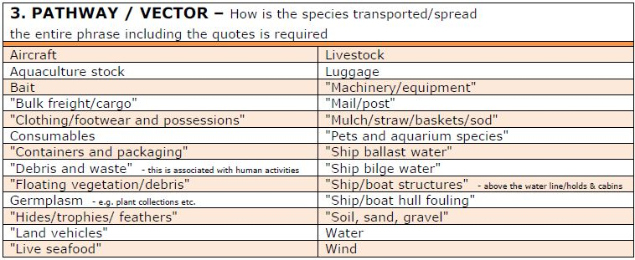
Creating lists using controlled vocabulary
The controlled vocabulary in the Advanced Search help document allows searches listing species transported by a particular vector…

Slide 18
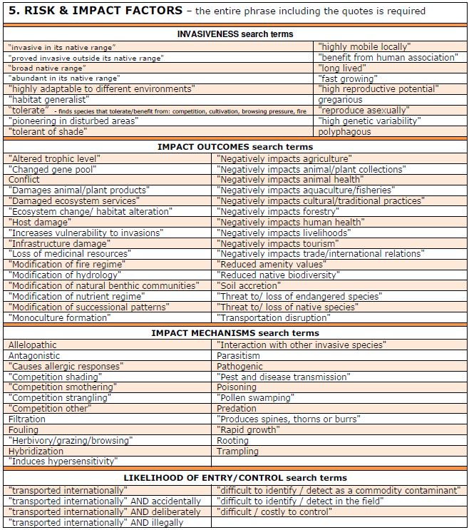
.. creating more lists using controlled vocabulary
The controlled vocabulary in the Advanced Search help document also allows searches listing species associated with particular risk or impact factors…

Slide 19
Common problems and troubleshooting
If you have any problems using Advanced Searches at an ‘expert’ level there are a number of things to check:
It is the Advanced Search being used and not the simple Site Search.
If a prefix is being used (e.g., GEO, INT, INV, HOS, etc.), check that the prefix and the other search term are enclosed within quotation marks (“search string”)
Check controlled vocabulary:
Advanced Search Help document contains controlled vocabulary for; countries and regions, pathways and vectors, habitats, and risk and impact factors
Using the HOS prefix, it may be worth checking the preferred name for a species in the on-line CAB Thesaurus (http://www.cabi.org/cabthesaurus.

Slide 20
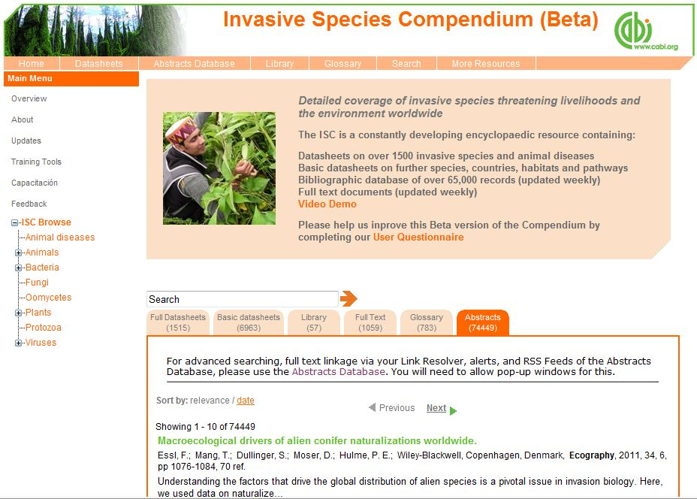
Invasive Species Compendium: Bibliographic, or ‘Abstracts’ database
Abstracts tab listing bibliographic records
Notes:
As well as datasheets, the Compendium provides access to over 75,000 bibliographic records, most of which contain abstracts and of which over 1000 also contain links to full text documents.
This collection of bibliographic records is an invasive species-related sub-set of the CAB Abstracts database, which is the most comprehensive database on agriculture and the environment in the world, with over eight million bibliographic records.
The collection of bibliographic records in the Compendium is updated weekly, the most recently added records can be seen by clicking the ‘Abstracts’ tab visible on the Home Page. By default, the most recently added records are shown.

Slide 21
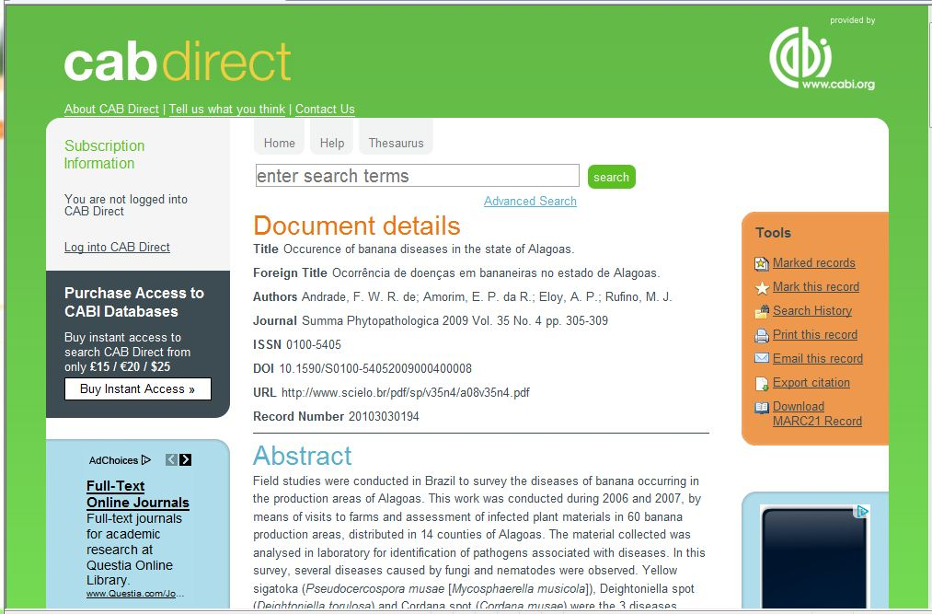
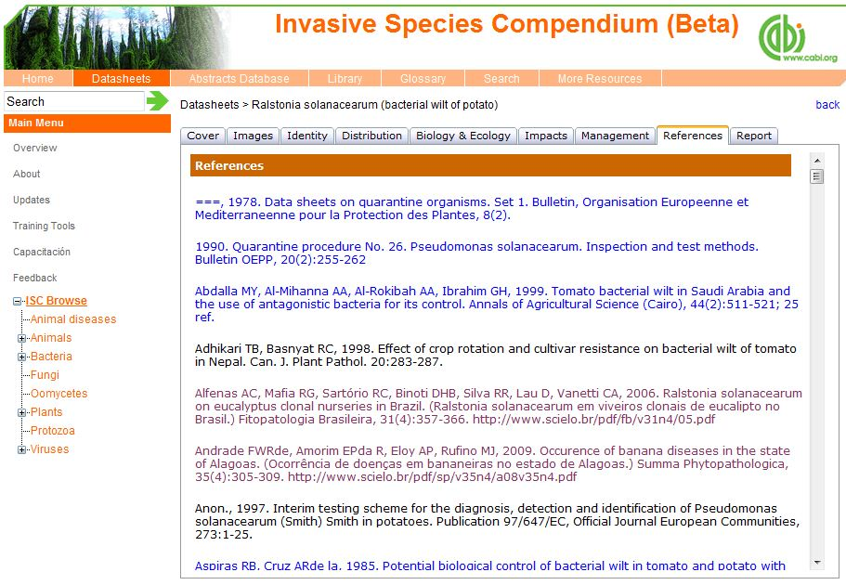
Bibliographic records – linkage with datasheets
Note that this CAB Abstracts record has a link to an open access PDF document
Click a linked reference to view the corresponding record in CAB Direct
Notes:
Where possible, references within a datasheet are linked with the corresponding bibliographic database in the CAB Abstracts database, and it is possible to view that record, by clicking on it in the reference list. This is possible as it is made available through CAB Direct, CABI’s own bibliographic search platform.

Slide 22
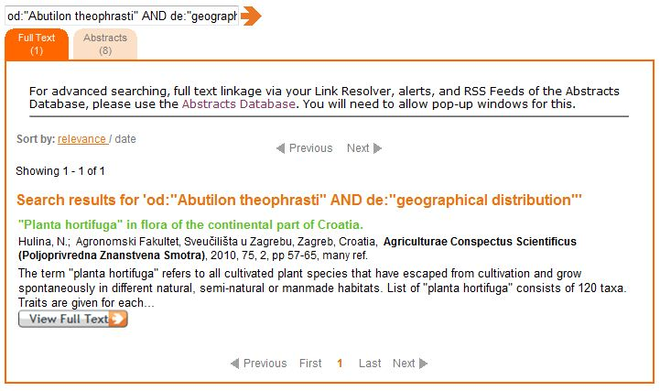
Advanced searching of bibliographic references in the Compendium
Since this search uses field searches (od and de) that are associated with the bibliographic database only, there are no datasheet results for this site search of the Compendium
Notes:
It is possible to adapt some techniques used for searching the CAB Abstracts database on CAB Direct to searching the Compendium bibliographic database through the Compendium Site Search.
Above is an example of searching the Compendium bibliographic database for records on the geographic distribution of Abutilon theophrasti, using the search string:
od:"Abutilon theophrasti" AND de:"geographical distribution“
od = organism descriptor
de = descriptor (indexing using controlled vocabulary from CAB Thesaurus)
Note that the Boolean operator ‘AND’ is capitalized. One of the search results is a bibliographic record that also contains a link to a full text document.

Slide 23
… some more example searches to try…
Full Text articles
Description: This search finds all full text records in the Compendium
Search string: sc:ft
The interception and/or quarantine of invasive species
Description: This search finds general records relating to the interception and quarantine of invasive species
Search string: de:"invasive species" AND (de:interception OR quarantine)
Insect vectors of plant diseases
Description: This search finds records on insect vectors of plant diseases
Search string: (de:"disease vectors" AND "insect pests") AND (de:"plant diseases" OR "plant pests")
New geographic records of Callidiellum rufipenne since 1 January 2000
Description: This search finds new geographic records of Callidiellum rufipenneadded (Japanese cedar longhorn beetle) added to the database since 1 January 2000.
Search string: (id:Callidiellum rufipenne) AND (de:new geographic records) AND ex:[20000101 TO *]
Notes:
Searching bibliographic records is a training subject in its own right. There are a number of free resources available from the www.cabi.org website giving advice and guidance in searching bibliographic databases. From the Home Page, click on ‘Publishing products’, and then Resources for… Database users in the left-hand menu (direct link; http://www.cabi.org/default.aspx?site=170&page=2042).

Slide 24
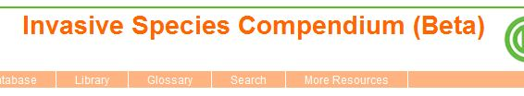
Further resources available through the Compendium
Although most of the data in the Compendium are held within its datasheet and bibliographic databases, there are further resources that may be of use, notably:
Library: a collection of especially selected PDF documents.
Glossary: a glossary of terms based on that collated for the Crop Protection Compendium
More resources: external links to Image libraries, Identification keys and the CABI invasives blog
Notes:
This training manual has mainly covered the Compendium in terms of its major content, the collections of datasheets and bibliographic records. The user of the Compendium will also find it worthwhile to explore the other resources available through the Compendium, in particular, the collection of documents that make up its ‘Library’, the Compendium Glossary, and the external links collected that point towards other resources such as identification keys and image libraries.

Slide 25
Self-test activities
Make a list of species in the Compendium registered as being transported via Forestry or any other Pathway datasheet of interest to you.
Take a look at the Country datasheet for your country and the lists of species and diseases? If possible, copy and paste the organisms listed into an Excel spreadsheet. Manipulate the data to obtain a lists of species present and, if possible, lists differentiating native species, introduced species, and known invasives for your country.

Slide 26
Self-test activities
Use the Advanced search to create a list of species reported as present in a particular country.
Refine that list using ‘expert’ searching to create one list of species labelled as native in that country, and another of species introduced to that country.
Create a list of species that are present in your first selected country but not present in a near or neighbouring country.

Slide 27
Self-test activities
Create a list of species that are present in a chosen country and are also listed as being associated with freshwater habitats.
Use ‘Expert Searching’ to create a list of invasive species that are transported and vectored in ship ballast water.
Create a list of invasive species for which cassava acts as a host

Slide 28
Self-test activities
Look at the ‘Search Help’ text and use it to create a list of nematodes of plants that are covered as full datasheets in the Compendium
Carry out a search of the bibliographic database to retrieve records on a particular species of interest that also relate to interception or quarantine.
Use the Compendium to find another on-line resource designed to help identify pests of maize in Southern Africa.

Slide 29
After using this training manual on the Invasive Species Compendium you should be able to…
Find useful species listings in different types of datasheet
Use the Advanced Search function to create lists of species covered in full datasheets that relate to a particular country
Use ‘expert’ search techniques to refine lists of species recorded for individual countries to relate to native, introduced or invasive species
Use expert search techniques to create other lists of interest relating to particular host species, habitats, vector pathways, or risks and impacts.
Apply some bibliographic searching techniques to interrogate the Compendium’s Abstracts database
Find other useful resources through the Compendium such as identification keys and image libraries relating to invasive species

Slide 30
This manual was produced as part of EUROPEAN COMMISSION DIRECTORATE-GENERAL ENVIRONMENT Contribution Agreement N° 21.0401/2011/609860/SUB/B2: "Updating, maintaining and enhancing the Invasive Species Compendium"

